Slide 1
LibraryProject
By : Yixin Liu
Course : 420-SF2-RE DATA STRUCTURES AND OBJECT ORIENTED PROGRAMMING

Slide 2
Outline/Table of content
Project Description
Program Features + Screenshots
Challenges Faced
Learning Outcomes

Slide 3
Project description
LibraryProject is a Java-based application which allows to add or remove books and manage the inventory. Members can search for books, borrow them, and return them. The app maintains borrowing history, enforces return deadlines, and calculates fines for late returns.

Slide 4
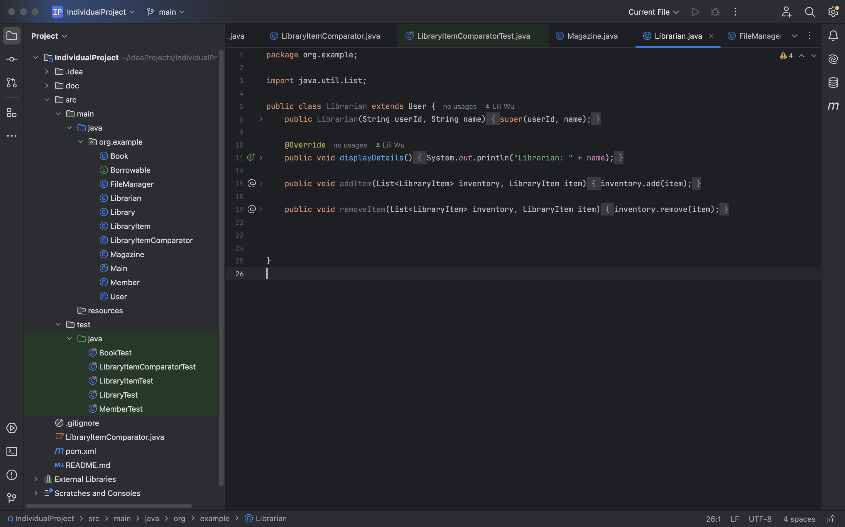
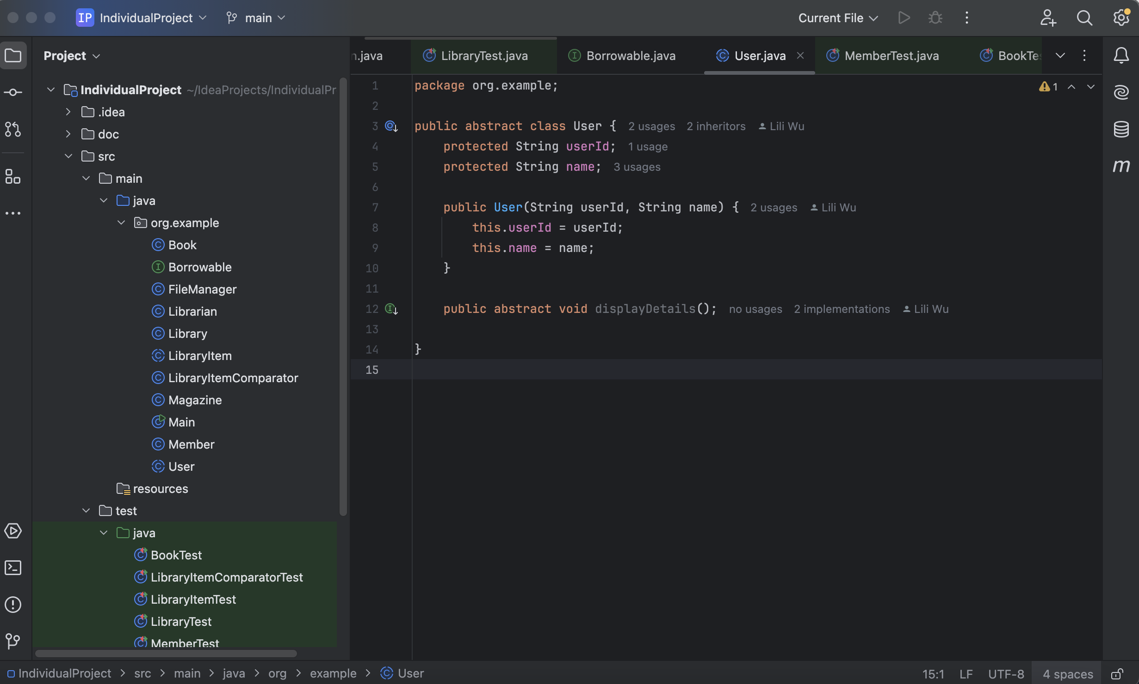
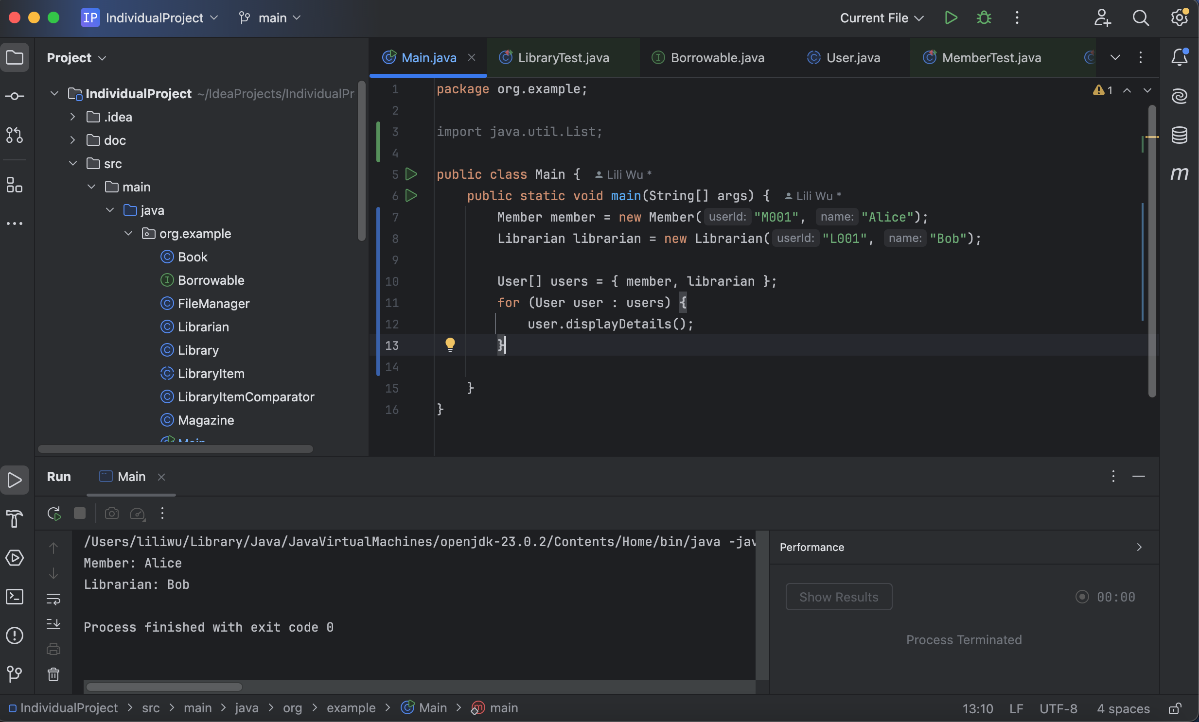
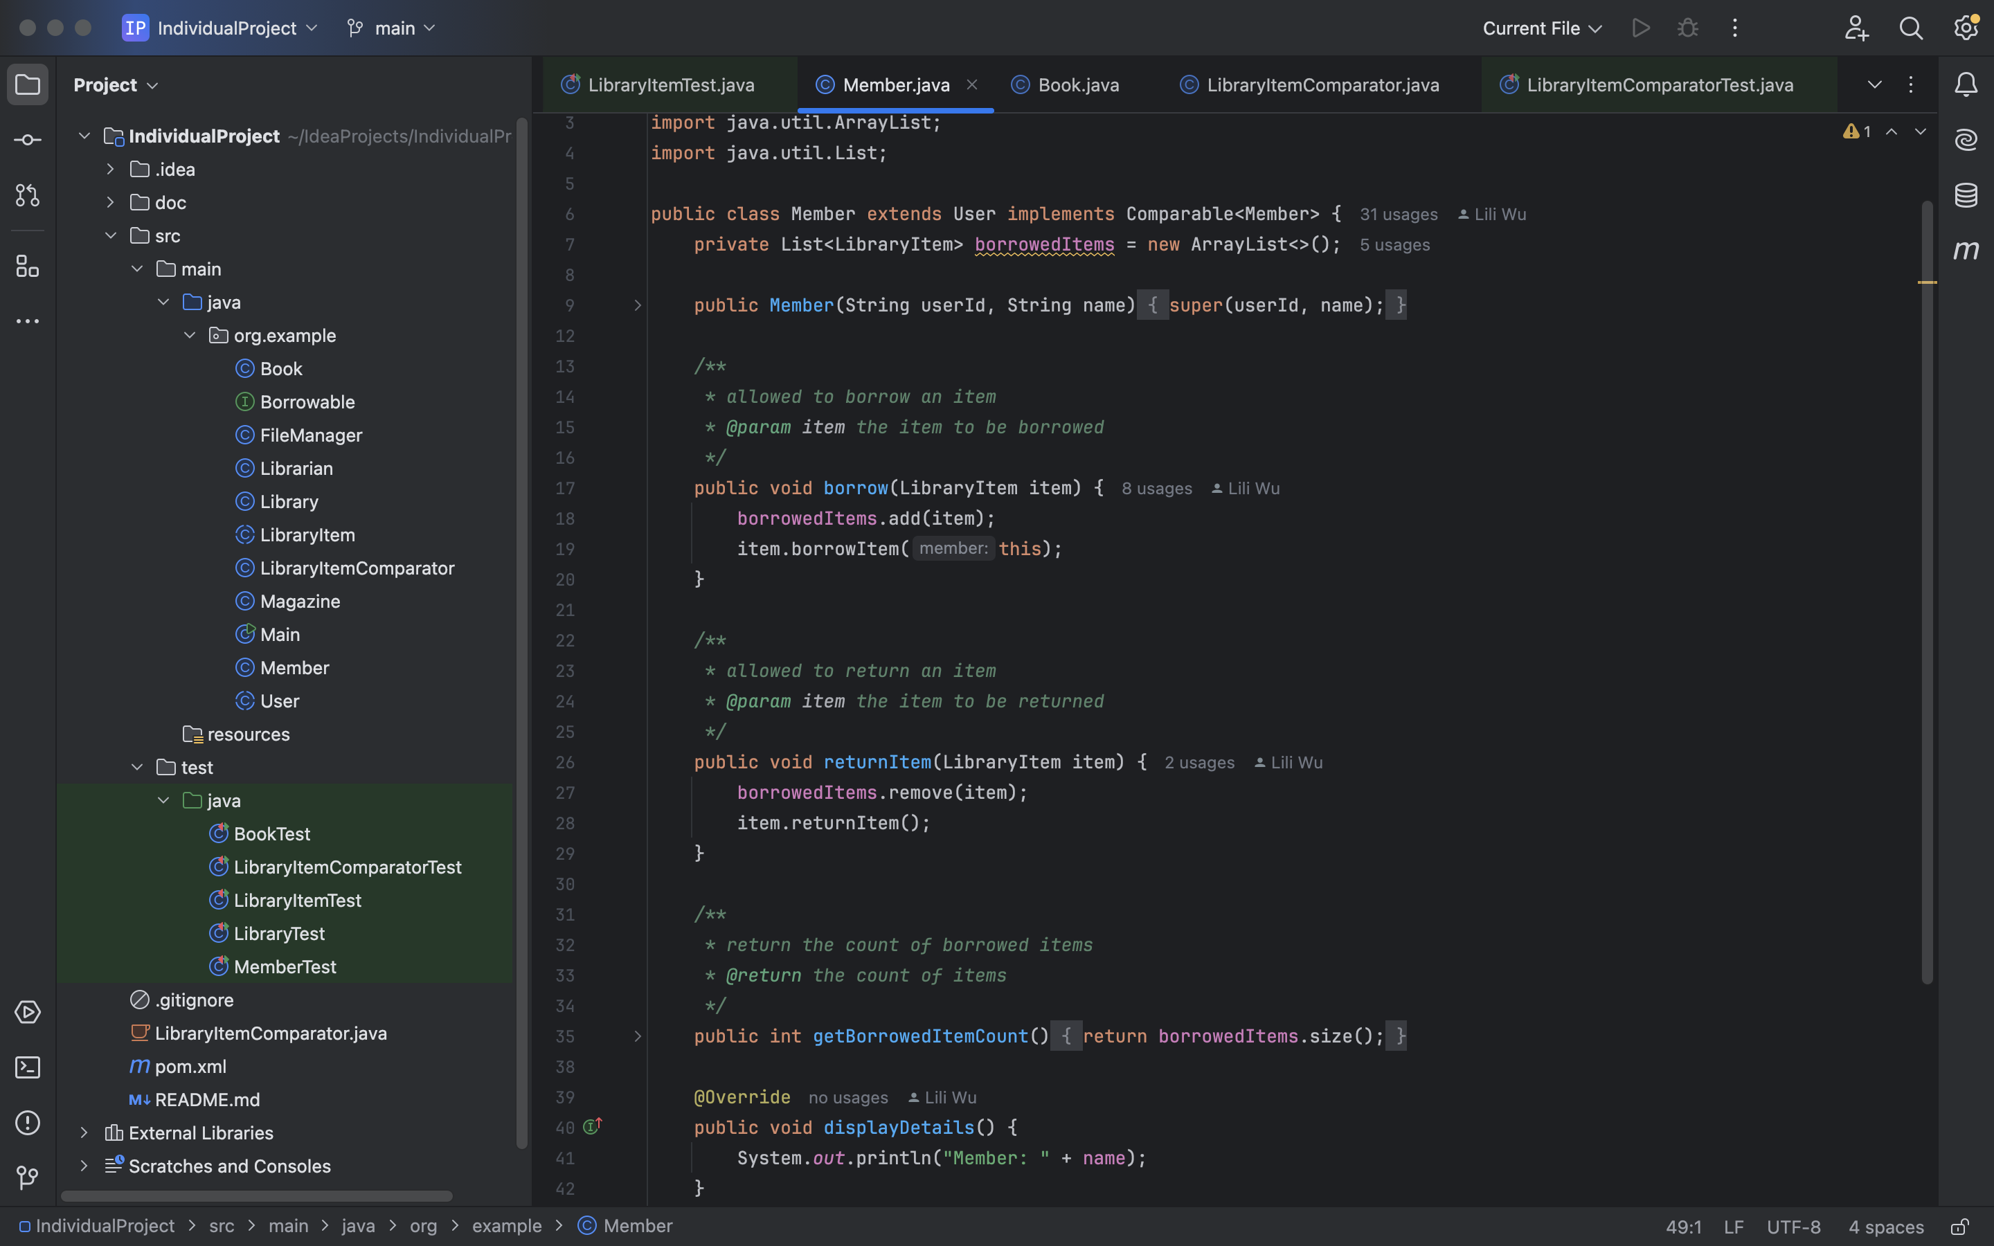
Program Features
Hierarchical user system: Abstract User class extended by Member and Librarian. Each user type overrides the displayDetails() method to demonstrate runtime polymorphism.
Example :

Slide 5
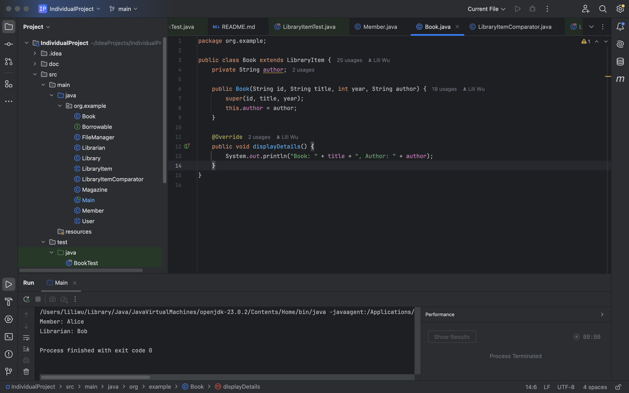
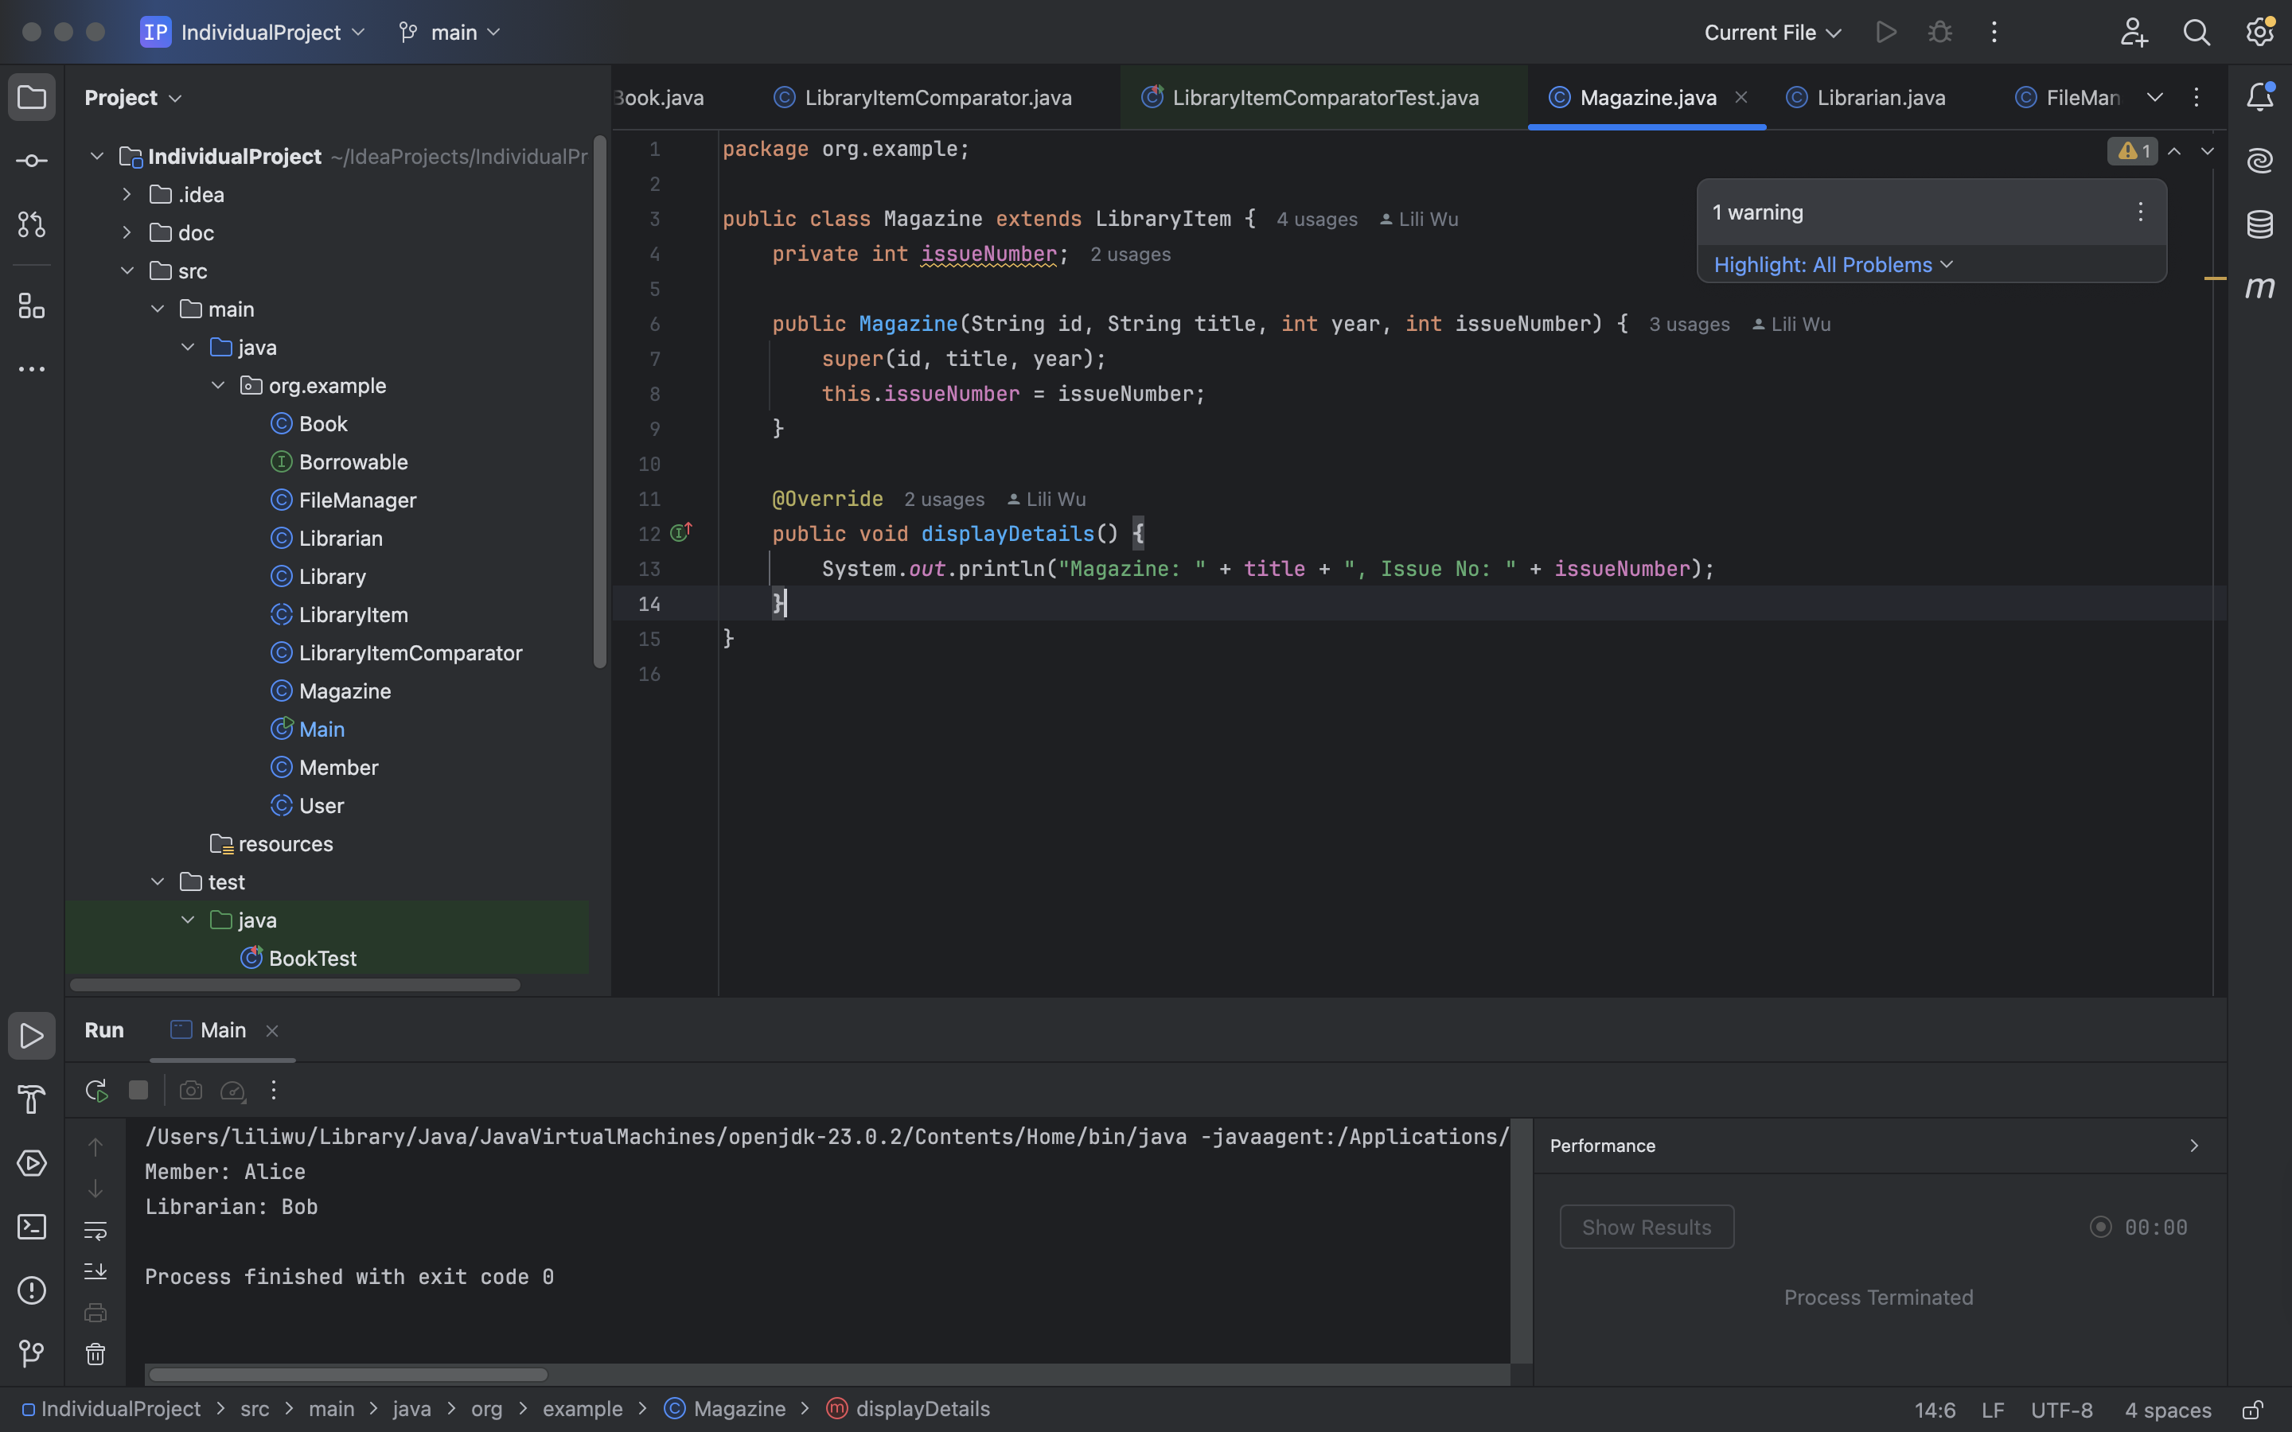
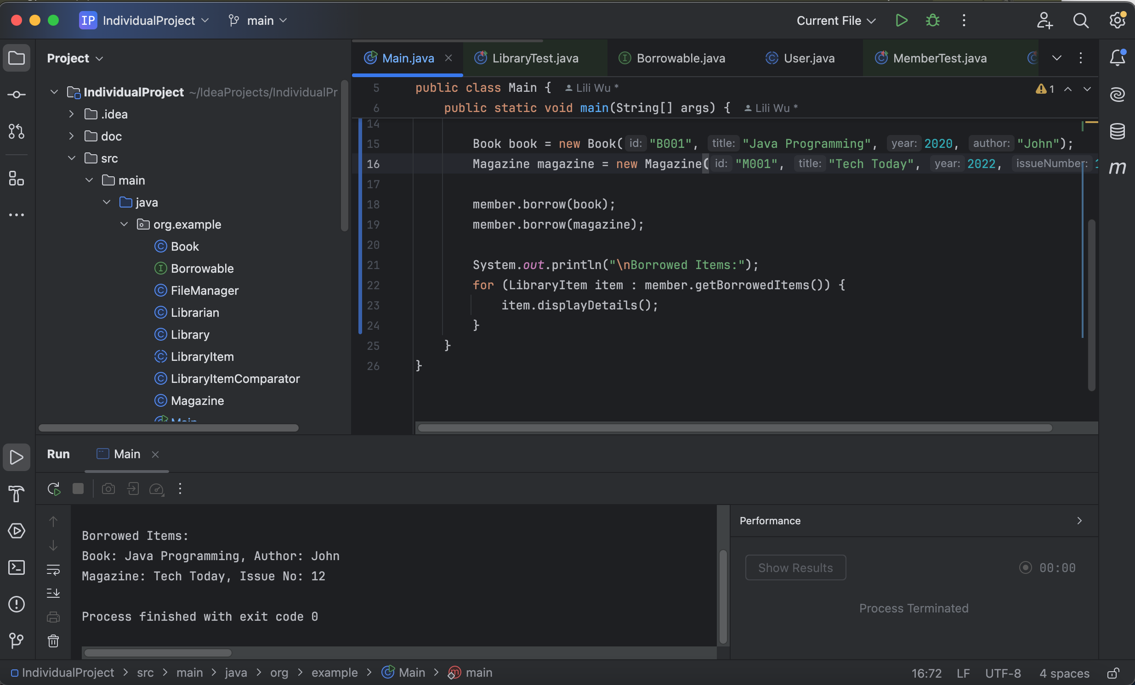
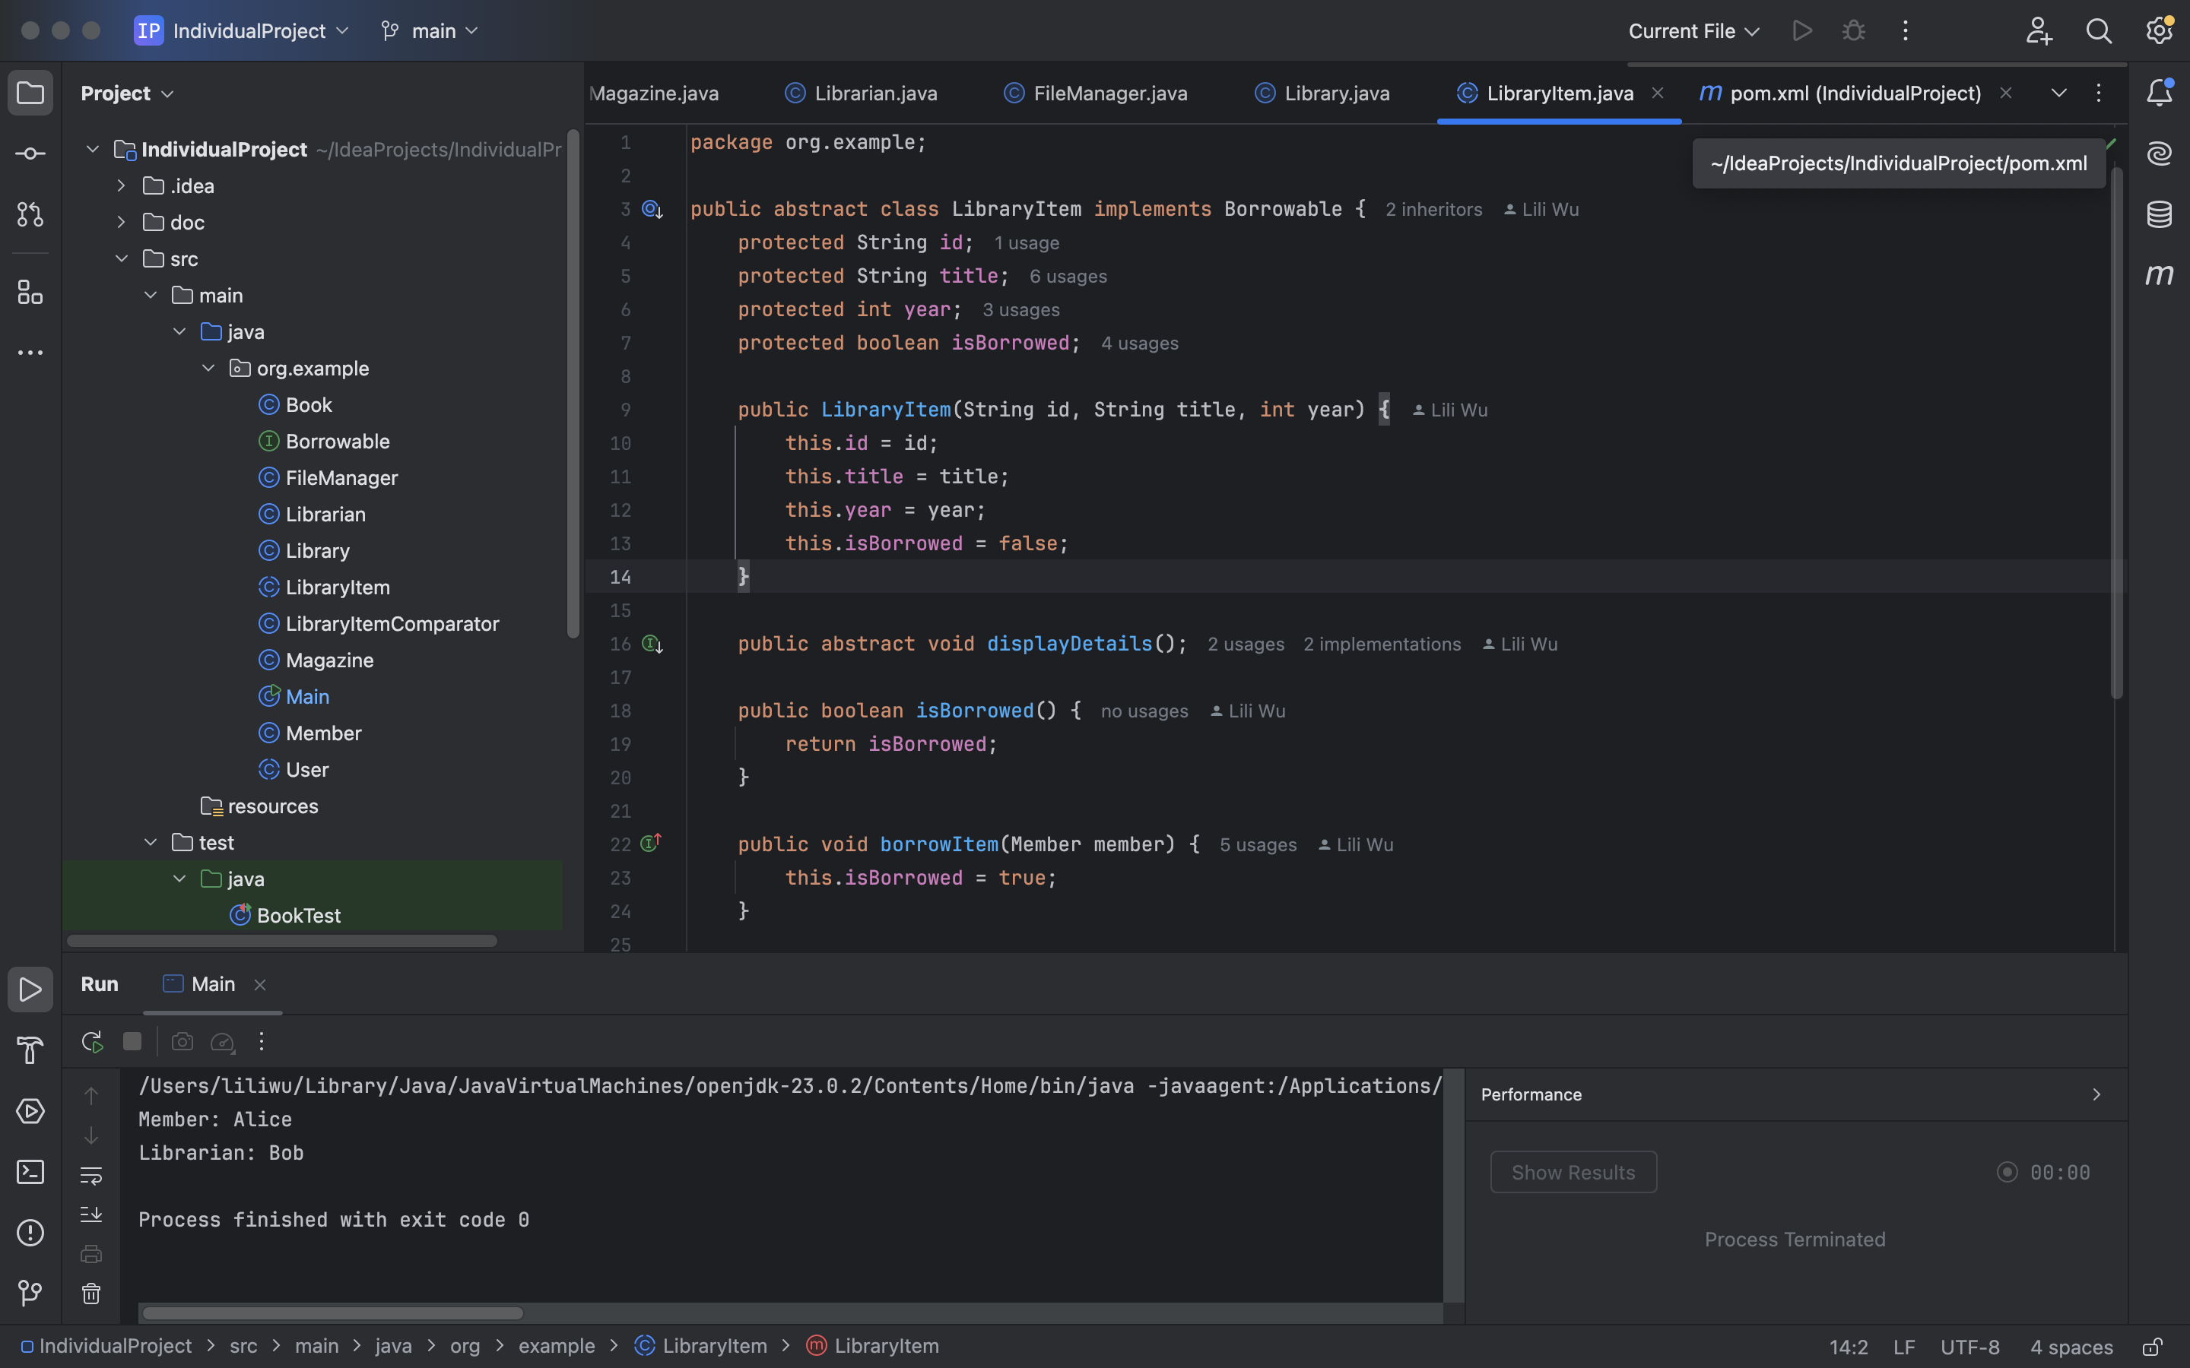
Program Features
Library Item Classification : The abstract class LibraryItem defines shared properties of all items. Book and Magazine extend this class.
Example :

Slide 6
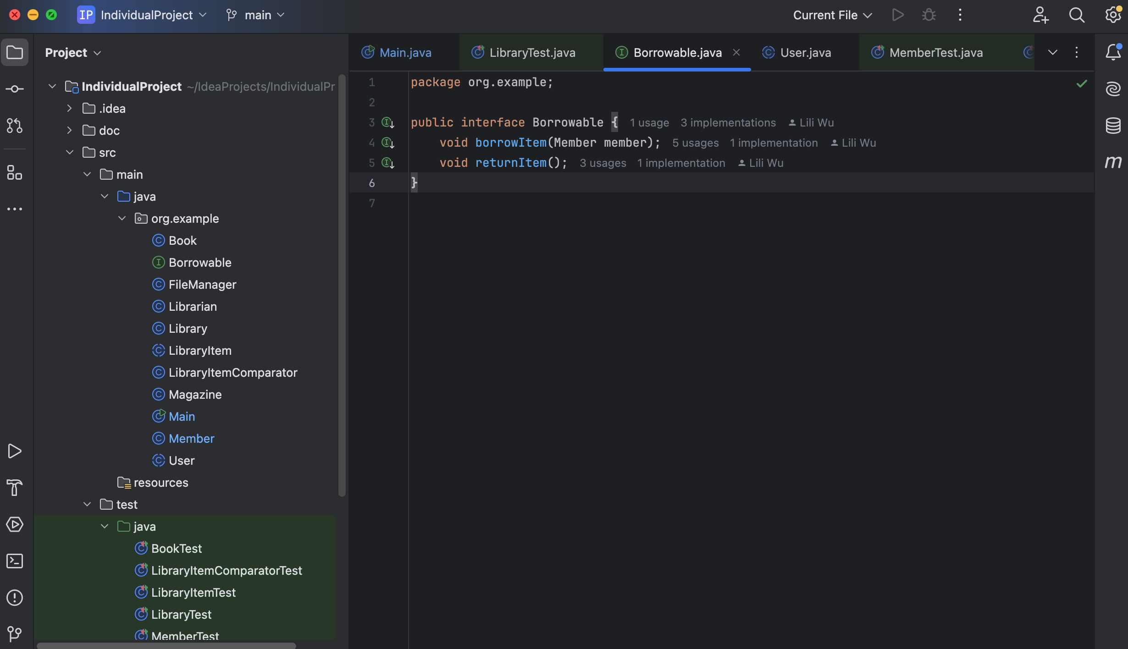
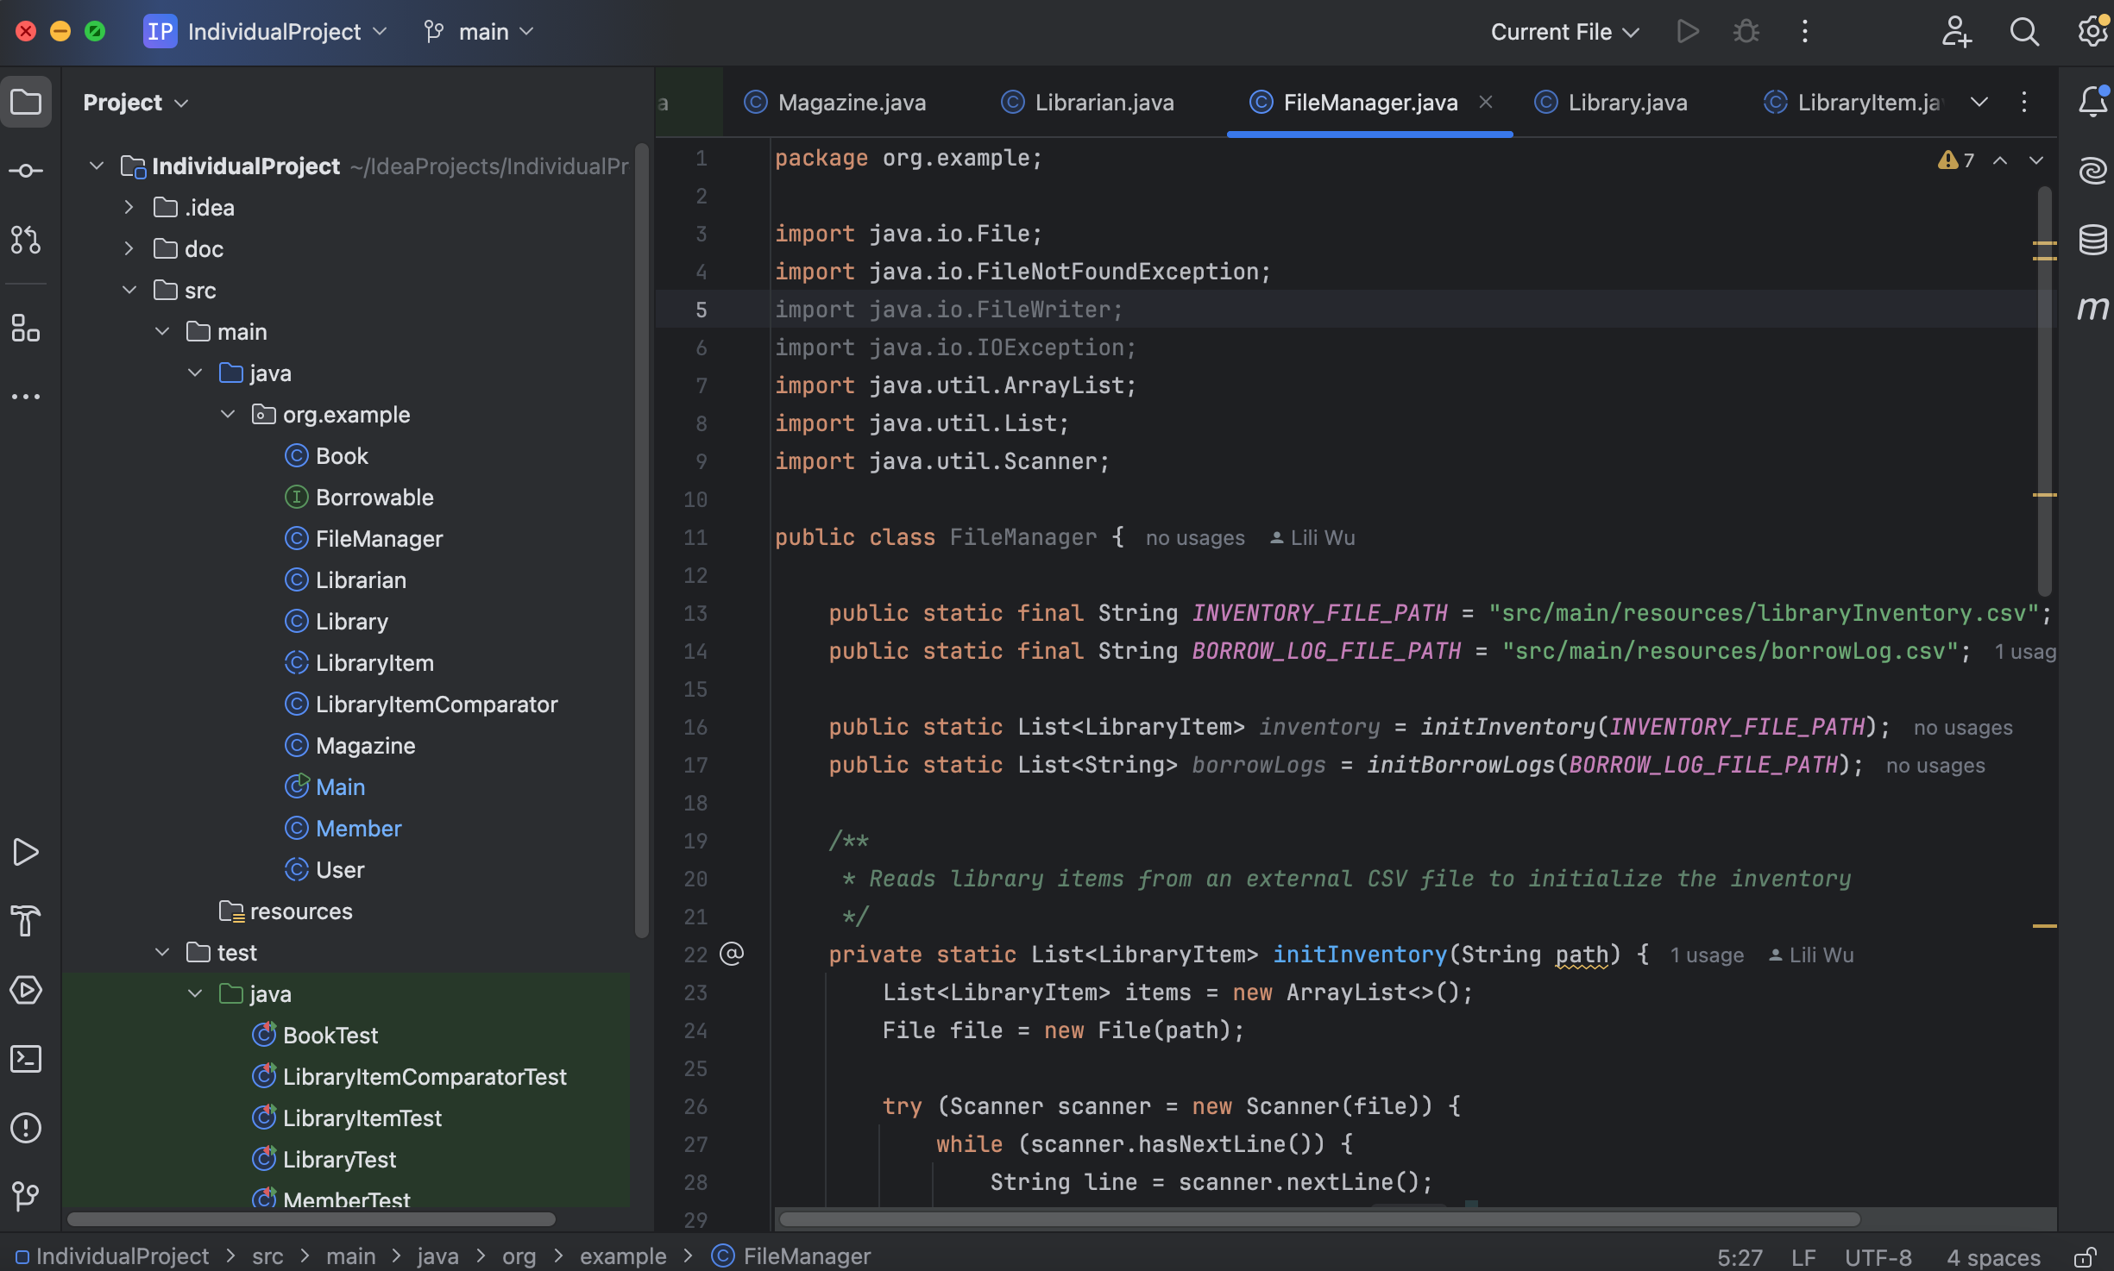
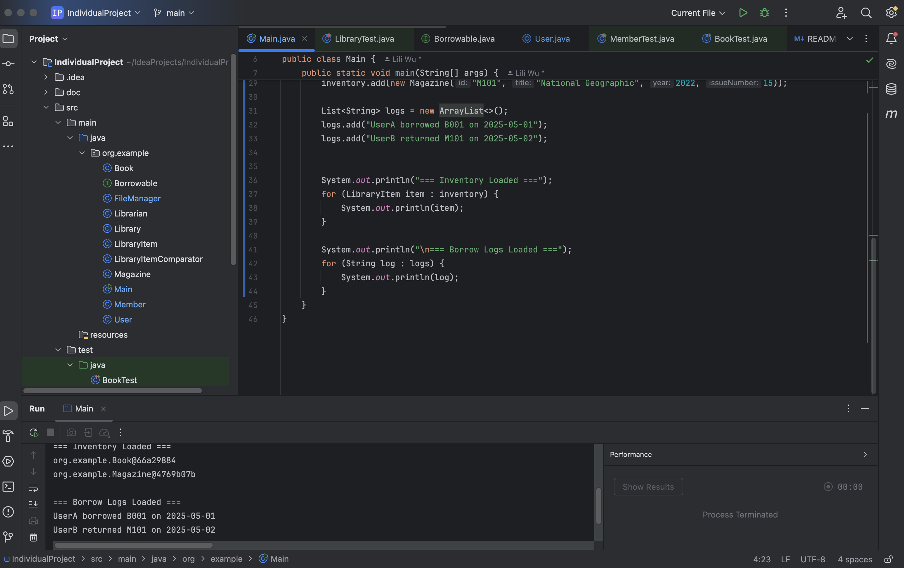
Program Features
Borrowable interface : Allows items to use borrowItem() and returnItem() methods
FileManager : The system uses LibraryFileManager to save borrow logs and load items from files.
Example:

Slide 7
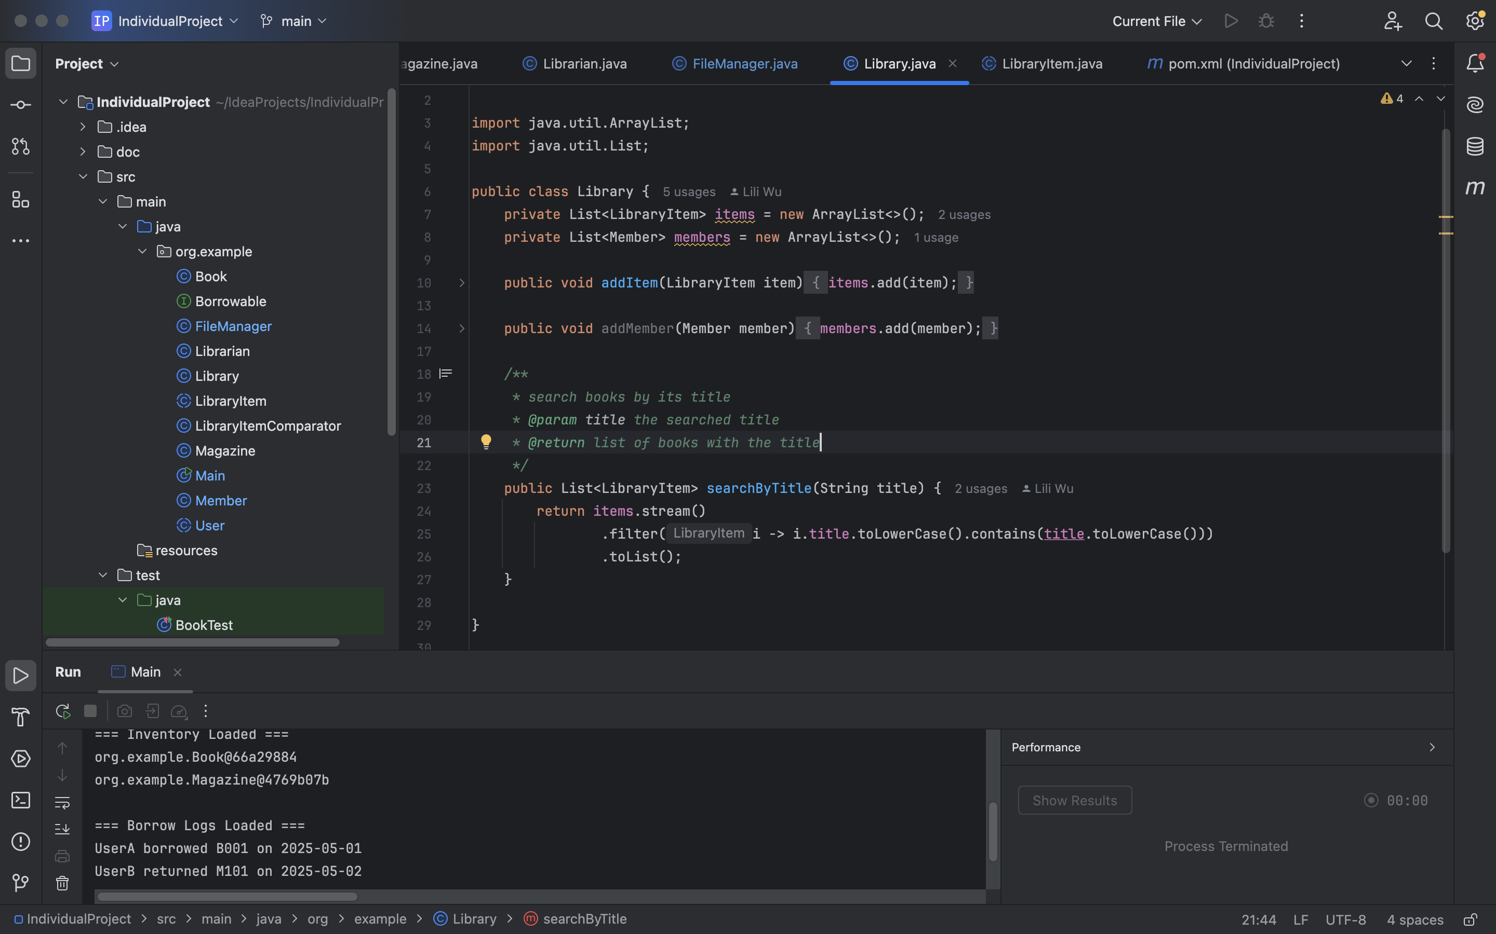
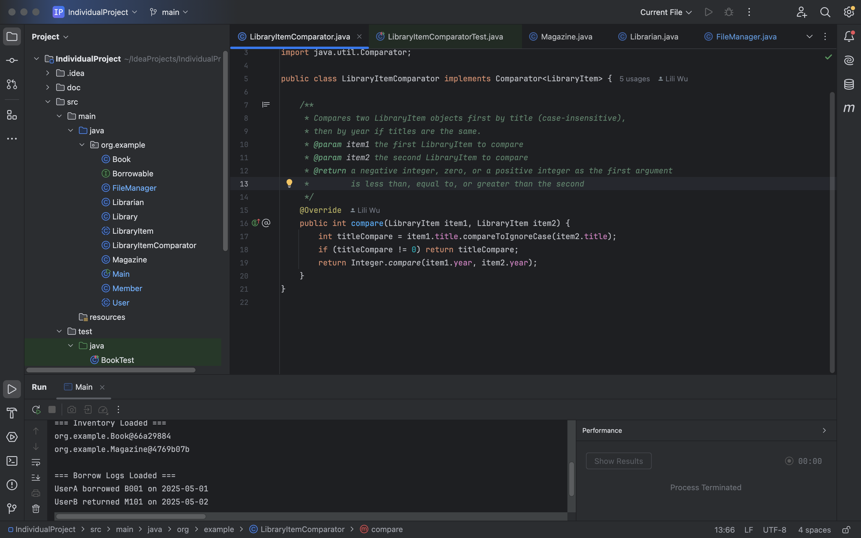
Program Features
Library : Use stream and lambda to search items
LibraryItemComparator : Compare items by title first, than with year

Slide 8
Challenges
What function give to each class
Make sure all the requirements are archived
How to implements file I/O methods correctly

Slide 9
Learning Outcomes
How to use Junit testing quicker
More experience about inheritance and abstract methods
Create better java doc for a method

